Slide 1
Corp Operations Department Presented by: Brent Voigtschild
CAPT Duncan McKay, USN
Commanding Officer
Dr. Angela Lewis, SES
Technical Director
Statement A: Approved for Public Release; Distribution is unlimited

Slide 2
NAVSEA ENTERPRISE
Combating our nation’s greatest threats, NSWC Crane is the indispensable mission expert, leveraging our deep technical heritage to deliver solutions through innovation and strategic partnerships.

Slide 3
STRATEGIC APPROACH
NAVSEA STRATEGIC FRAMEWORK
NSWC CRANE STRATEGY PROCESS
ELEMENTS OF STRATEGIC INTENT
Strategic Intent >>
Strategic Targets
Mission/Business Areas
Execution
Culture
Brand
Workforce
Workload
Infrastructure
Ecosystem

Slide 4
GUIDING PRINCIPLES
CRANE VALUES
HONESTY
Build meaningful relationships based on empathy, gracefully speaking the truth to one another.
Create an inclusive culture that values leadership and employee engagement.
INTEGRITY
Demonstrate and model virtue by intentionally cultivating consistent, ethical behavior.
SERVICE
Support the mission by selflessly committing time, energy,
and talent.
Integrate capabilities and processes to enable efficient and effective execution of our mission.
UNITY
Innovate game-changing and agile solutions.
Foster a sense of community through problem-solving, mutual respect, and building each other up.
EMPOWERMENT
Embrace collaborative solutions by trusting others and accepting responsible risk.
SOLUTIONS

Slide 5
DETER
DEFEND
DEFEAT
STRATEGIC MISSIONS
CONTROL THE SPECTRUM
CONTROL THE FIGHT
EXPEDITIONARY WARFARE
RAPID RESPONSE
PROVEN SOLUTIONS
ELECTRONIC WARFARE
MISSION SUCCESS
BUSINESS EXCELLENCE

Slide 6
BUSINESS DEPARTMENTS THRUST AREAS
Notes:
Integrated Business Department approach developed in the 2018/2019 timeframe
Dane Speer, Dr. Lewis, Kelly Siffin, Rick McGarvey, Roger Clark, Jarad King, Melinda Hendrix
Very intentional about operational readiness (about today) helping the three line departments execute our collective mission.
We are here because we add value and further the mission.

Slide 7
CORPORATE OPERATIONS DEPARTMENT – CODE 10
Assets, Operating Materials and Supplies (OM&S), General Equipment
413 government employees
2459 new computers, 2000 web cameras, and 4500 headsets deployed in FY21
Hired 248 permanent & 43 students in FY21
Answered 315 external data calls
16,561 Purchase Orders
Social media following of 23,993 people
Property Management
Business & Financial Management
Corporate Business Office
Environmental
Security
Corporate Communications
Safety
Human Resources
Information Technology
Infrastructure
Equal Employment Opportunity, Diversity, & Inclusion
Recruiting, Employee Development, Training, Crane Division University
Funds Acceptance and Management
Facilities, Maintenance, Construction Management
Networks, Telephones, Computers
Counseling, Diversity, Inclusion, Reasonable Accommodations, Special Emphasis Programs
Corporate Measures, Technical Capability Health Assessment, Records Management, Workload Planning, Awards
Explosive Safety, Radiation Safety, Occupational Safety & Health
Air Management, Hazardous Waste, Pollution Prevention, Hazardous Material
Internal and External Communication
Access Control, Operational Security, Personnel Security

Slide 8
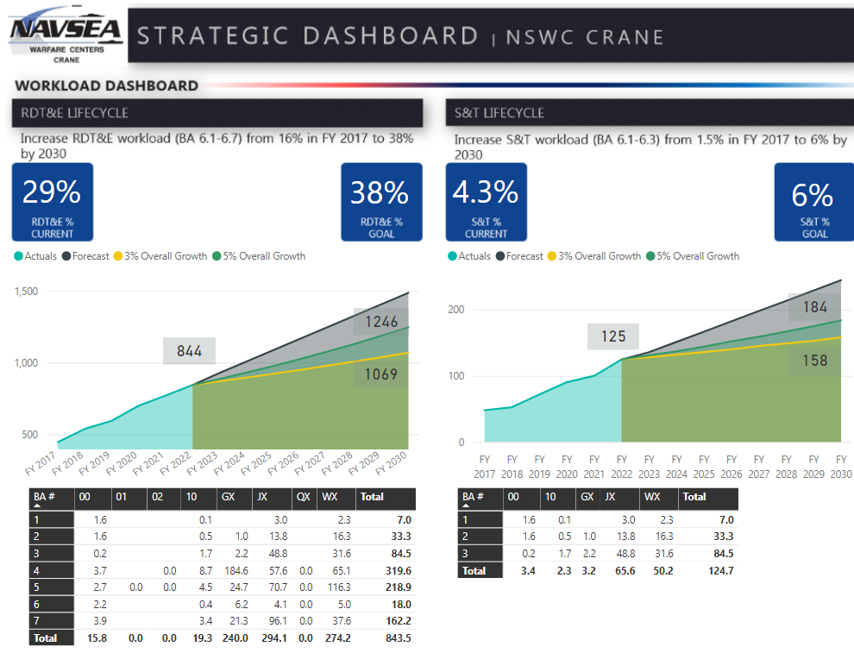
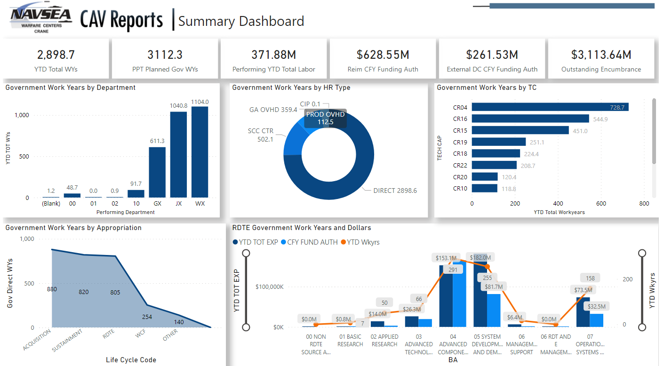
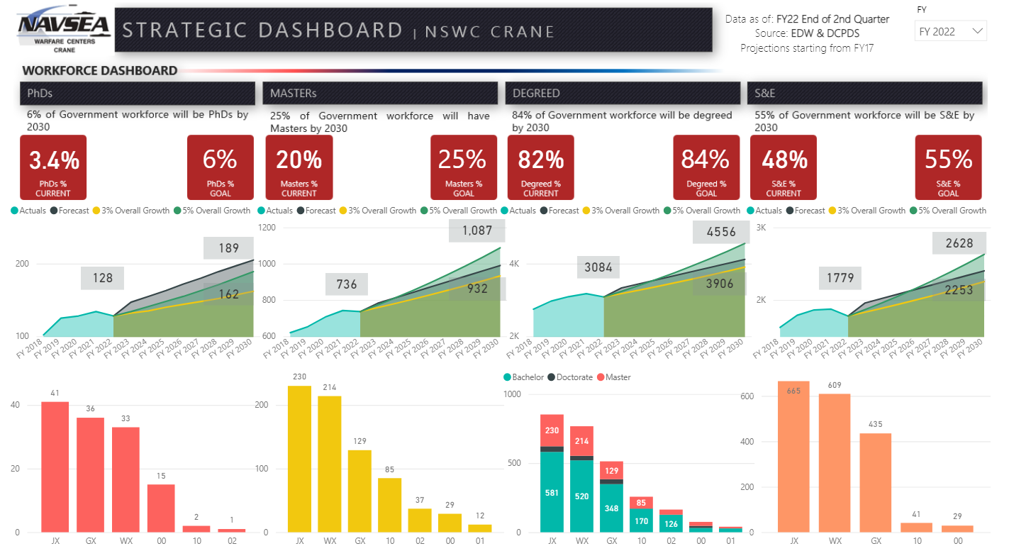
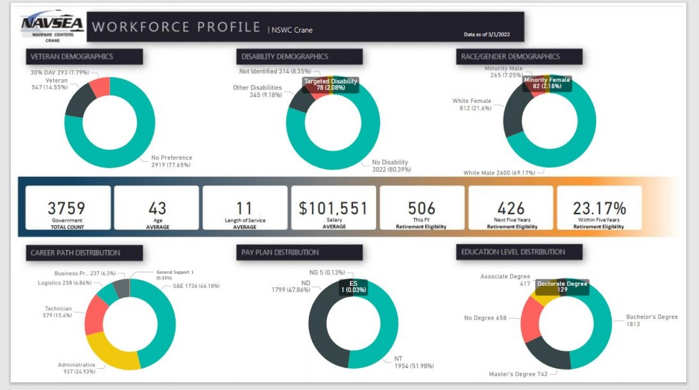
CORP BUSINESS OFFICE AUTOMATED DASHBOARDS

Slide 9
COMPTROLLER – CODE 01
Funds Management & Corporate Budget
70 government employees
In FY21, processed 7,217 Incoming Funding Documents from Crane Sponsors resulting $871M of Reimbursable Acceptance
In FY21, accepted $705.7M of direct cite funds
In FY21, processed 1,272,600 Revenue bearing transactions
Budget Division
Payroll
Accounting Division
Travel Services
Corporate Financial Accounting, Managerial Accounting, Vendor Pay
​The Comptroller Department is responsible for Command financial execution through the establishment and maintenance of Policy, Processes, and Controls in the areas of Budget, Accounting, and Employee Services (such as Travel and Payroll)
Travel orders, Passports

Slide 10
CONTRACTS DEPARTMENT – CODE 02
206 government employees
In FY21, Actual Total Obligations: $1,775.153 M
In FY21, Savings negotiated: $101.5 M
Portfolio Value: $6.0B
Spectrum Warfare Contracts
Acquisition Policy and Oversight
Expeditionary Contracts
Global Deterrence & Defense Contracts
The Contracts Department strives to keep America's Navy #1 in the world by delivering to our customers and the Warfighter high quality acquisition products and services, while maintaining the public's trust, fulfilling public policy objectives, and judiciously embracing a culture of affordability.
The vision of our contracts Department is to satisfy customer requirements through the timely delivery of high quality acquisition products and services with a diverse, well-trained and innovative Contracting workforce.

Slide 11
BUSINESS DEPARTMENT FUTURE PRIORITIES
Advanced Data Visualization
Trends!
Dynamic Visualization (Changes over time)
Advanced Analytics
Human Capital projections
Financial Rate setting
Business Applications for Artificial Intelligence / Machine Learning
Milestone planning for contract packages
Strategic environmental scanning and assessment
Market Segment Analysis
Natural Language Processing
Automation:
Financial Reporting
How do we more effectively leverage SQL, Python, R, statistics, modeling across our workforce?
Interactive 55 year infrastructure plan that forecasts the replacement of HVAC, roofs, carpet, furniture, etc.

Slide 12
WORKFORCE INNOVATION
Characteristics of our Workforce
Foster a Diverse and Inclusive work environment to support an empowered workforce
Deep technical and analytical expertise and passion for technology
Collaboration for rapid solutions
Competitive incentives to inspire employees to the next step
Advancing workforce skill sets with continuous learning and credentialing
Growth to meet Mission demand
Focus on talent attraction and retention
Experts in Mission applications of emerging technologies

Slide 13
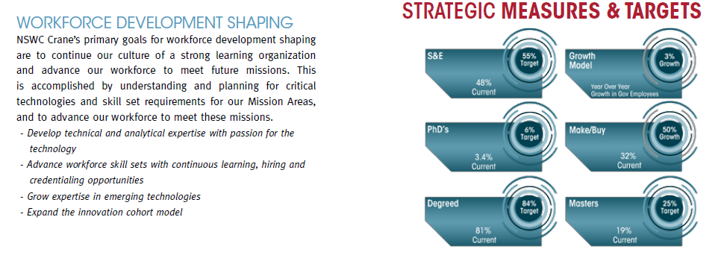
WORKFORCE GOALS
Key Skillsets Needed:
Electrical Engineers
Computer Engineers
Cybersecurity
Data Scientists
Information Technology (IT)
Optical Engineers
Hypersonics
Aerospace Engineers

Slide 14
ECOSYSTEM PARTNERS
CONDITIONS FOR SUCCESS
Innovation Labs
Engagement
Office
B34 HiVe
Committed Leadership
Dedicated Investment
Deliberate Collaboration
Engaged Workforce
Offsite Assignments
Regional Partnerships
Temp Faculty
PhD Goal
S&T Report
Chief Tech Office
NISE/219 Program
Innovation Discovery Events
IU Mesh
Workforce Development Programs

Slide 15
Questions ?

